Slide 1

KHATRA ADIBASI MAHAVIDYALAYA
P.O- Khatra, Dist.-Bankura, West Bengal, Pin-722140
Name of the Teacher- Monojit Mondal
Class- B.A. Program in Physical Education 5th semester
Subject- Physical Education
Course : Indigenous & Minor Game and Excursion- Camping Program
Topic- Skills and Raiding
Session: 2019-20

Slide 2
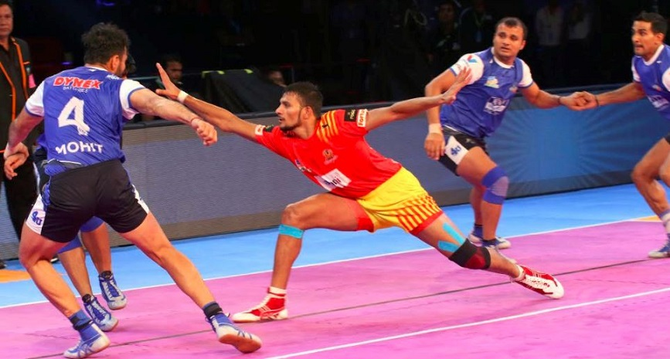
Skills and Raiding
1: Touching with hands
Although this is one of the most basic offensive skills in Kabaddi, it requires plenty of practice in order to successfully apply it during a raid. This Kabaddi raiding skill involves tagging one or more defenders with either hand to score points for the raiding team (more defenders tagged, more points scored). Touching the defenders with the tip of a finger also counts.

Slide 3
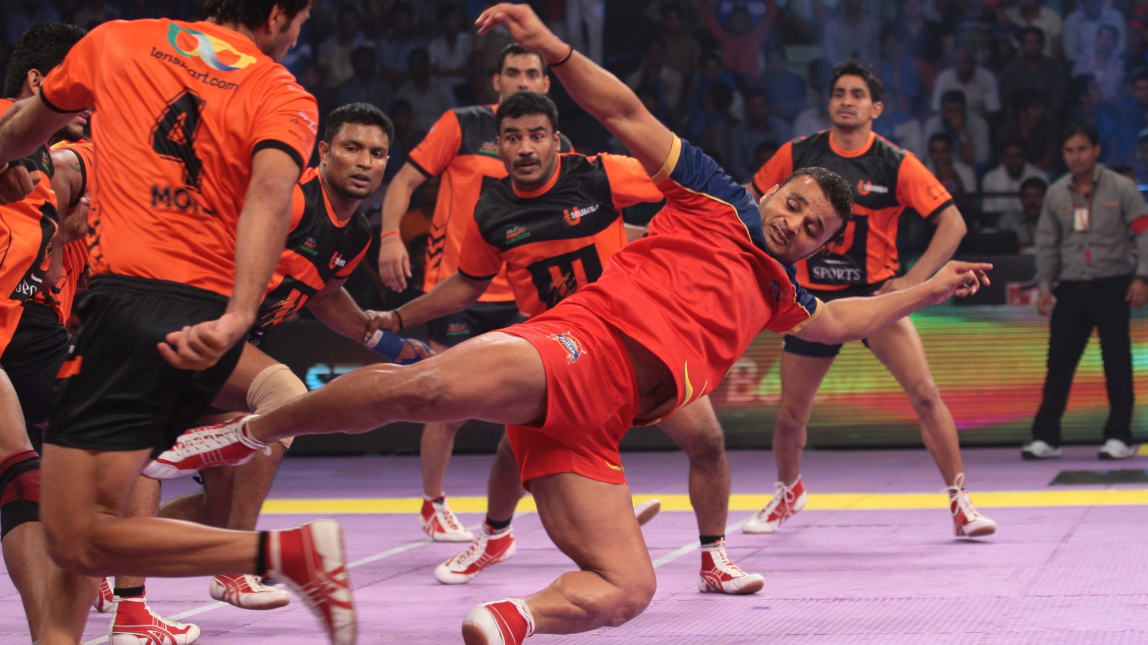
2 The Foot Touch

Slide 4
2 The Foot Touch
The foot touch is also among the fundamental skills of Kabaddi that raiders commonly use to score points. When executing this Kabaddi raiding skill, the raider uses his entire foot, instead of just a toe, to tag one or more defenders. Physical fitness and leg strength in particular are required for the execution of this skill which typically involves a single-leg hip thrust in the direction of the target. The raider then proceeds with dragging his foot towards the defenders in an attempt to touch one or more – this is known as “SLIP” in Kabaddi. The slip enables the raider to rapidly cover a larger area of the defending team’s half of the court, maximizing his chances of touching defenders with his foot.

Slide 5
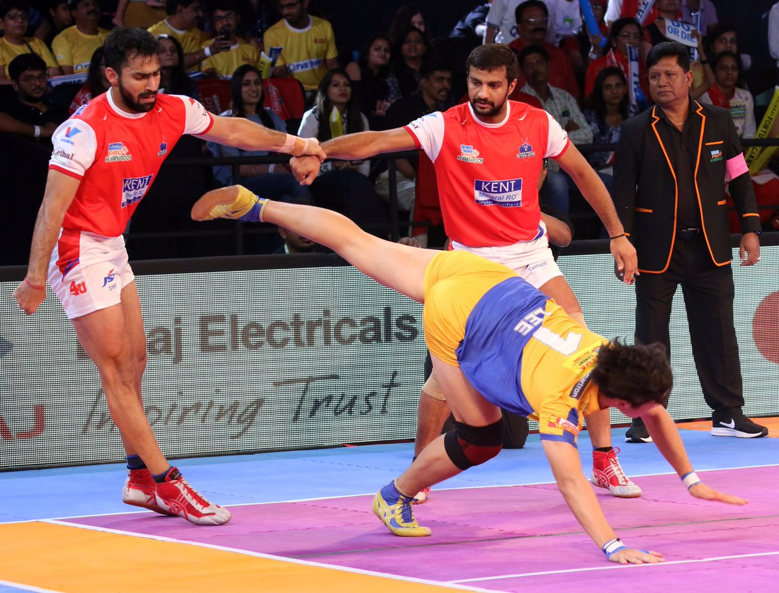
3. Mule kick
A very deceptive skill in which a raider changes his/her stance within a fraction of a second and kicks backward looking for touch points.

Slide 6
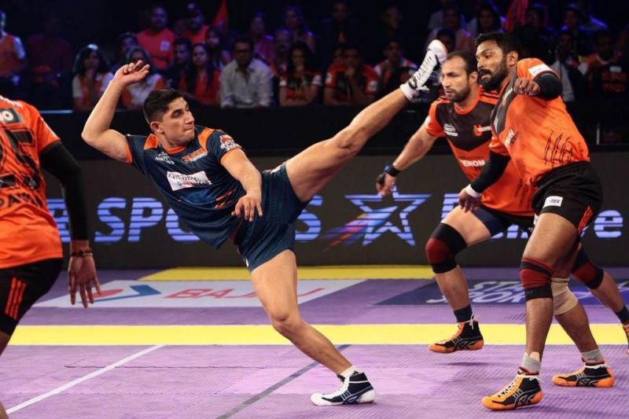
Side kick
In this move, a raider attempts to get a touch on a defender by kicking sideways without losing balance. A raider must have the ideal body balance and center of gravity.

Slide 7
References
https://kabaddi.site/offensive-skills/
https://www.google.com/search?q=side+kick+in+kabaddi&rlz=1C1CHNY_enIN1033IN1033&hl=en-US&source=lnms&tbm=isch&sa=X&ved=2ahUKEwil3-TKjc78AhWm6jgGHUp4BIoQ_AUoAXoECAEQAw&biw=1366&bih=600&dpr=1#imgrc=srNj-UnpptM_cM
https://www.prokabaddi.com/features/fundamental-kabaddi-skills-of-raiders-defenders-fans-must-know-pro-kabaddi

